Slide 1



Nama Pengajar:
Dian Ade Kurnia, M.Kom
Rusnanda Farhan
Rusnandi Fikri
Rika Sahriana
Neural Network on Image and Text Data

Slide 2





Outline
Introduction to Text and Image Data
Convolutional Neural Network (CNN)
Recurrent Neural Network

Slide 3
Introduction to Text and Image Data

Slide 4
Preprocessing on Text Data
Case Folding
Slang Words Handling
Stopword Removal
Case folding is an operation to convert all text into lowercase or uppercase. The purpose of this operation is to normalize words into the same form in case (e.g. “The” and “the” will be treated as two different unigrams if no case-folding).
We write a dictionary to map slang word into formal word. The purpose is to normalize words from different form that have same meaning into same formal word.
Example :
Mantab -> mantap
Klo -> kalau
Yg -> yang
Krn -> karena
In computing, stop words are words which are filtered out before or after processing of natural language data (text). Though “stop words” usually refers to the most common words in a language, there is no single universal list of stop words used by all natural language processing tools, and indeed not all tools even use such a list. The purpose of stopwords filtering is to focus on “meaningful” words in sentences/documents.
Stemming
Vectorization
In linguistic morphology and information retrieval, stemming is the process of reducing inflected (or sometimes derived) words to their word stem, base or root form.
Example :
Memukul, dipukul -> pukul
Membuat -> buat
Vectorization is a technique in text processing that used to transform text into representative vector using some method such as TF-IDF, CountVectorizer, Word Embedding, etc.

Slide 5
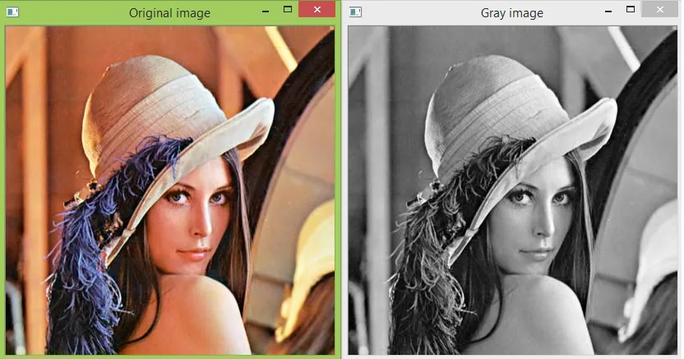
Preprocessing on Image Data
Changing Color Space
Color spaces are a way to represent the color channels present in the image that gives the image that particular hue.

Slide 6





Preprocessing on Image Data
Morphological Transformation
Original Image
Opening
Closing
Erotion
Dilation

Slide 7
Convolutional Neural Network (CNN)

Slide 8
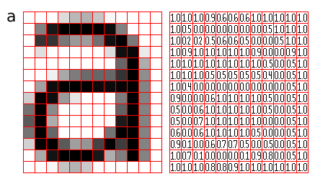
Convolutional Neural Network
A Convolutional Neural Network, also known as CNN or ConvNet, is a class of neural networks that specializes in processing data that has a grid-like topology, such as an image. A digital image is a binary representation of visual data. It contains a series of pixels arranged in a grid-like fashion that contains pixel values to denote how bright and what color each pixel should be.

Slide 9

Convolutional Neural Network Architecture

Slide 10

Convolution Layer
The convolution layer is the core building block of the CNN. It carries the main portion of the network’s computational load.
This layer performs a dot product between two matrices, where one matrix is the set of learnable parameters otherwise known as a kernel, and the other matrix is the restricted portion of the receptive field. The kernel is spatially smaller than an image but is more in-depth. This means that, if the image is composed of three (RGB) channels, the kernel height and width will be spatially small, but the depth extends up to all three channels.

Slide 11
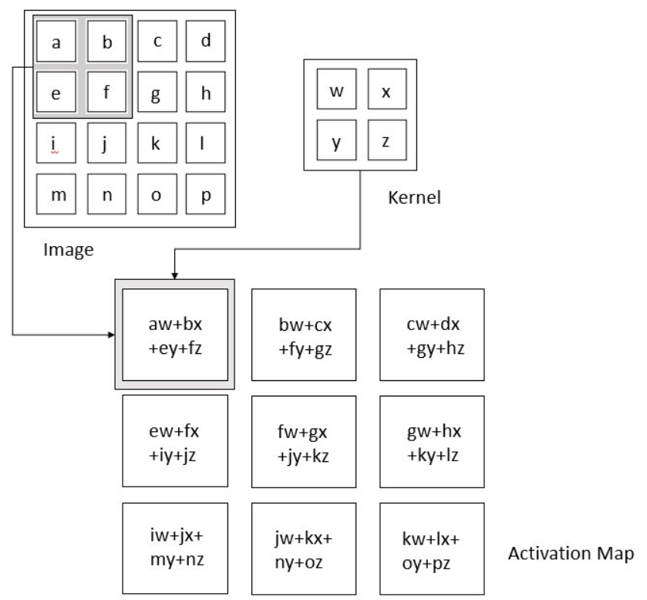

Slide 12
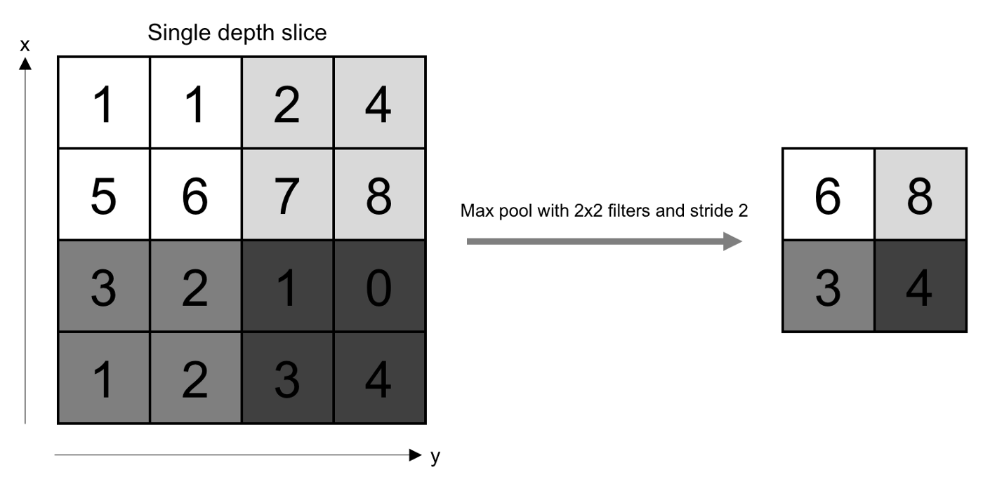
Pooling Layer
The pooling layer replaces the output of the network at certain locations by deriving a summary statistic of the nearby outputs. This helps in reducing the spatial size of the representation, which decreases the required amount of computation and weights. The pooling operation is processed on every slice of the representation individually.
There are several pooling functions such as the average of the rectangular neighborhood, L2 norm of the rectangular neighborhood, and a weighted average based on the distance from the central pixel. However, the most popular process is max pooling, which reports the maximum output from the neighborhood.

Slide 13
Fully Connected Layer
Neurons in this layer have full connectivity with all neurons in the preceding and succeeding layer as seen in regular FCNN. This is why it can be computed as usual by a matrix multiplication followed by a bias effect. The FC layer helps to map the representation between the input and the output.
Non-Linearity Layers
Since convolution is a linear operation and images are far from linear, non-linearity layers are often placed directly after the convolutional layer to introduce non-linearity to the activation map. There are several types of non-linear operations, the popular ones being: Sigmoid, Tanh, ReLU, etc.

Slide 14
Applications of CNN
Object Detection
Object detection: With CNN, we now have sophisticated models like R-CNN, Fast R-CNN, and Faster R-CNN that are the predominant pipeline for many object detection models deployed in autonomous vehicles, facial detection, and more.
Image Captioning
Image captioning: CNNs are used with recurrent neural networks to write captions for images and videos. This can be used for many applications such as activity recognition or describing videos and images for the visually impaired. It has been heavily deployed by YouTube to make sense to the huge number of videos uploaded to the platform on a regular basis.
Semantic Segmentation
Semantic segmentation: In 2015, a group of researchers from Hong Kong developed a CNN-based Deep Parsing Network to incorporate rich information into an image segmentation model. Researchers from UC Berkeley also built fully convolutional networks that improved upon state-of-the-art semantic segmentation.

Slide 15
Recurrent Neural Network (RNN)

Slide 16
Recurrent Neural Networks
RNNs are a powerful and robust type of neural network, and belong to the most promising algorithms in use because it is the only one with an internal memory.
Like many other deep learning algorithms, recurrent neural networks are relatively old. They were initially created in the 1980’s, but only in recent years have we seen their true potential. An increase in computational power along with the the massive amounts of data that we now have to work with, and the invention of long short-term memory (LSTM) in the 1990s, has really brought RNNs to the foreground.
Because of their internal memory, RNN’s can remember important things about the input they received, which allows them to be very precise in predicting what’s coming next. This is why they're the preferred algorithm for sequential data like time series, speech, text, financial data, audio, video, weather and much more. Recurrent neural networks can form a much deeper understanding of a sequence and its context compared to other algorithms.

Slide 17

Recurrent Neural Networks
The input layer ‘x’ takes in the input to the neural network and processes it and passes it onto the middle layer.
The middle layer ‘h’ can consist of multiple hidden layers, each with its own activation functions and weights and biases. If you have a neural network where the various parameters of different hidden layers are not affected by the previous layer, ie: the neural network does not have memory, then you can use a recurrent neural network.
The Recurrent Neural Network will standardize the different activation functions and weights and biases so that each hidden layer has the same parameters. Then, instead of creating multiple hidden layers, it will create one and loop over it as many times as required.

Slide 18
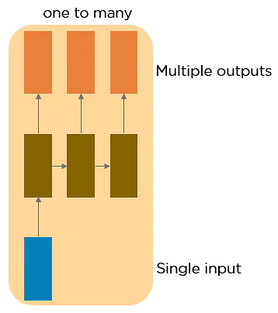
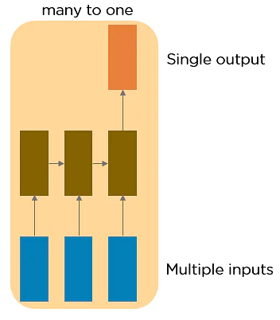
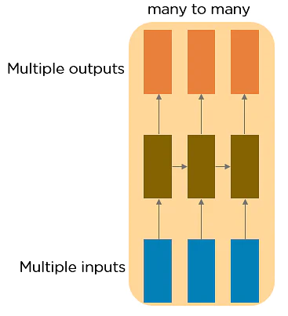
Types of Recurrent Neural Networks
One to One RNN
This type of neural network is known as the Vanilla Neural Network. It's used for general machine learning problems, which has a single input and a single output.
One to Many RNN
This type of neural network has a single input and multiple outputs. An example of this is the image caption.
Many to One RNN
This RNN takes a sequence of inputs and generates a single output. Sentiment analysis is a good example of this kind of network where a given sentence can be classified as expressing positive or negative sentiments.

Slide 19
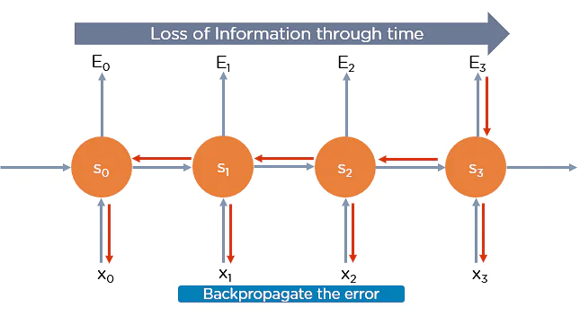
Two Issues of Standard RNNs
Exploding Gradient Problem
While training a neural network, if the slope tends to grow exponentially instead of decaying, this is called an Exploding Gradient. This problem arises when large error gradients accumulate, resulting in very large updates to the neural network model weights during the training process.
Long training time, poor performance, and bad accuracy are the major issues in gradient problems.
Vanishing Gradient Problem
Recurrent Neural Networks enable you to model time-dependent and sequential data problems, such as stock market prediction, machine translation, and text generation. You will find, however, RNN is hard to train because of the gradient problem.
RNNs suffer from the problem of vanishing gradients. The gradients carry information used in the RNN, and when the gradient becomes too small, the parameter updates become insignificant. This makes the learning of long data sequences difficult.

Slide 20
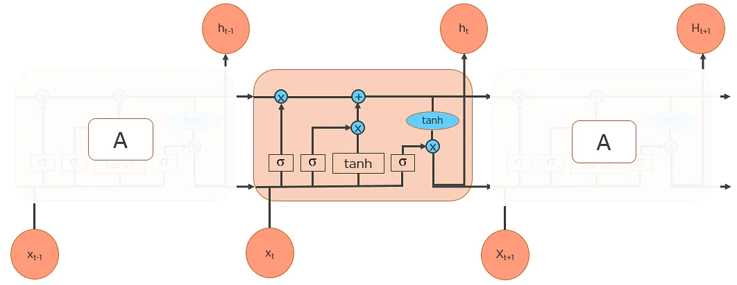
Long Short-Term Memory Networks
LSTMs are a special kind of RNN — capable of learning long-term dependencies by remembering information for long periods is the default behavior. All RNN are in the form of a chain of repeating modules of a neural network. In standard RNNs, this repeating module will have a very simple structure, such as a single tanh layer.
LSTMs also have a chain-like structure, but the repeating module is a bit different structure. Instead of having a single neural network layer, four interacting layers are communicating extraordinarily.

Slide 21
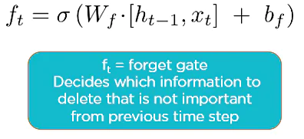
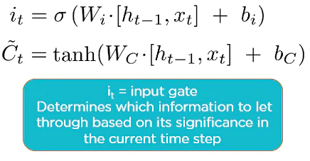
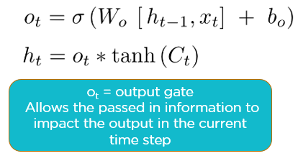
Workings of LSTMs in RNN
Step 1: Decide How Much Past Data It Should Remember
The first step in the LSTM is to decide which information should be omitted from the cell in that particular time step. The sigmoid function determines this. It looks at the previous state (ht-1) along with the current input xt and computes the function
Step 2: Decide How Much This Unit Adds to the Current State
In the second layer, there are two parts. One is the sigmoid function, and the other is the tanh function. In the sigmoid function, it decides which values to let through (0 or 1). tanh function gives weightage to the values which are passed, deciding their level of importance (-1 to 1).
Step 3: Decide What Part of the Current Cell State Makes It to the Output
The third step is to decide what the output will be. First, we run a sigmoid layer, which decides what parts of the cell state make it to the output. Then, we put the cell state through tanh to push the values to be between -1 and 1 and multiply it by the output of the sigmoid gate.

Slide 22
References
Deep Learning by Ian Goodfellow, Yoshua Bengio and Aaron Courville published by MIT Press, 2016
Stanford University’s Course — CS231n: Convolutional Neural Network for Visual Recognition by Prof. Fei-Fei Li, Justin Johnson, Serena Yeung
https://datascience.stackexchange.com/questions/14349/difference-of-activation-functions-in-neural-networks-in-general
https://www.codementor.io/james_aka_yale/convolutional-neural-networks-the-biologically-inspired-model-iq6s48zms
https://searchenterpriseai.techtarget.com/definition/convolutional-neural-network
https://towardsdatascience.com/illustrated-guide-to-recurrent-neural-networks-79e5eb8049c9
https://machinelearningmastery.com/an-introduction-to-recurrent-neural-networks-and-the-math-that-powers-them/
https://docs.opencv.org/4.x/d2/d96/tutorial_py_table_of_contents_imgproc.html

